Slide 1


Strengthening Local Government Cybersecurity: Threats, Services, and Response
Foua Xiong | Cyber Navigator – Local Governments

Slide 2
Agenda
Introduction: MNIT and Cyber Navigator Program
Cyber Threat Landscape – Attack Trends and Metrics
Incident Response – Approach and Best Practice
MNIT Services
How to Participate
Notes:
Here are the types of incidents to report

Slide 3


Minnesota IT Services (MNIT)
MNIT is the central IT organization for the State and partners with:
Executive Branch: agencies, boards, councils, and commissions in the state.
Non-executive branch: cities, townships, counties, school districts, higher education, public libraries, legislative branch, judicial branch, constitutional offices, law enforcement, and other government organizations in the state.

Slide 4

Cyber Navigator Program
Five Cyber Navigators +
  Supervisor
  Local Government: cities, townships, tribal governments
  K12 schools/Education
  Critical infrastructure
  Cyber Threat Intelligence
Assists Minnesota with cybersecurity tools and resources
Support grant-funded cyber security tools
Support the Minnesota Cybersecurity Task Force
Work with FBI, MNFC, DHS, BCA, state agencies, and others
Cyber Navigators: CN.MNIT@state.mn.us
Notes:
Where does your organization start? We can help with that! The EZ button to cybersecurity maturity.
Cyber defense and mitigation is complex – cyber navigators are here to help
By contacting the cybersecurity navigator team at the address above, we can help you get started.
Resources available now
Continuation of business, communication plans. Be prepared.
MN cyber navigators can you help find the right fit for your organizational maturity.

Slide 5

Cyber Threat Landscape
Cyber Threat Landscape

Slide 6
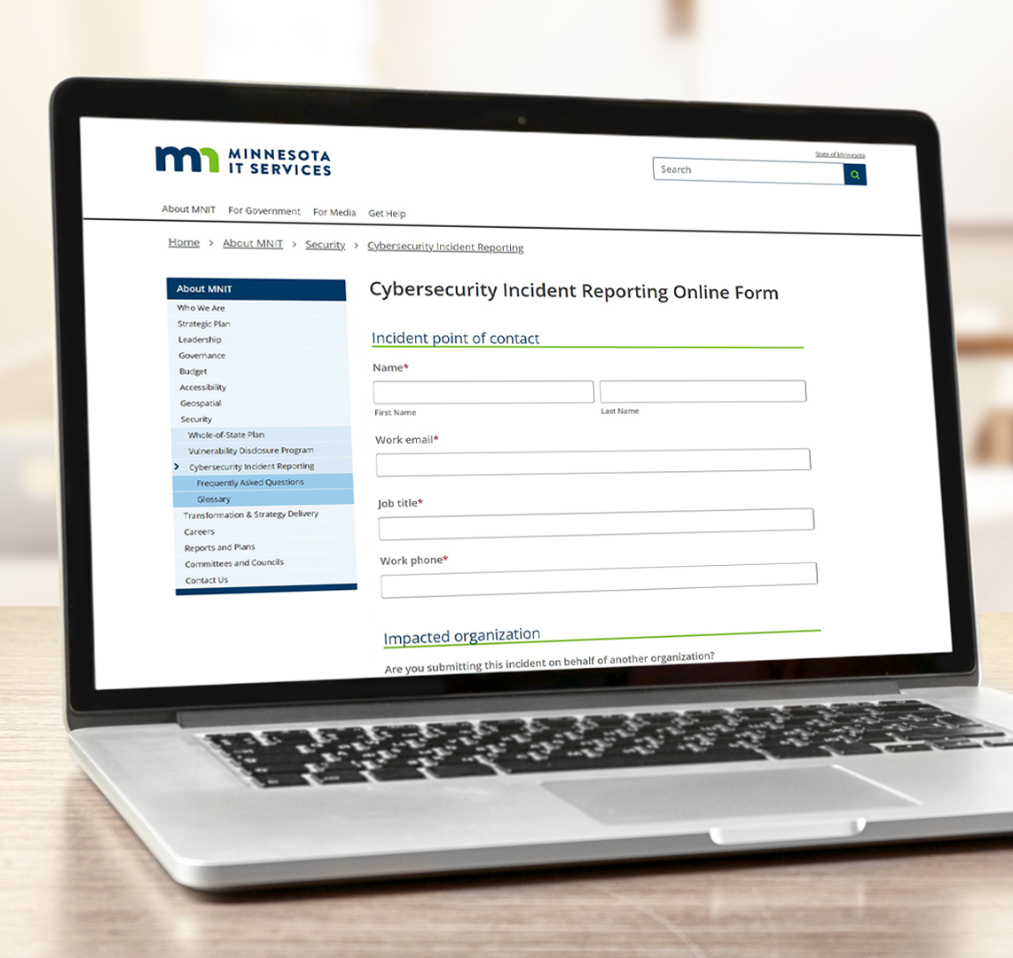
Cybersecurity Incident Reporting
Reporting tool: mn.gov/mnit/cir
Law took effect December 1, 2024
Requiring public sector organizations including K-12 schools, local governments, higher education institutions, and other political subdivisions to report cybersecurity incidents.
State may collect information about cybersecurity incidents, anonymize it, and share it with appropriate organizations to strengthen cyber defenses statewide
Notes:
eO 22-20

Slide 7
Cyber Incident Report Metrics
Report range: Oct 2024 – Current
Total 265 Reports
K12, County, City / Townships bulk of cyber incidents reports
Over 50% of reported incidents related to compromised accounts, phishing and other forms of social engineering
Attacks targeting users rather than systems

Slide 8
Phishing Kits
What are phishing kits?
  Pre-packaged tools used by cyber criminals to easily create phishing websites and campaigns
  Sold or distributed on dark web
  Enables Attackers with little technical skill to launch attacks quickly

Slide 9
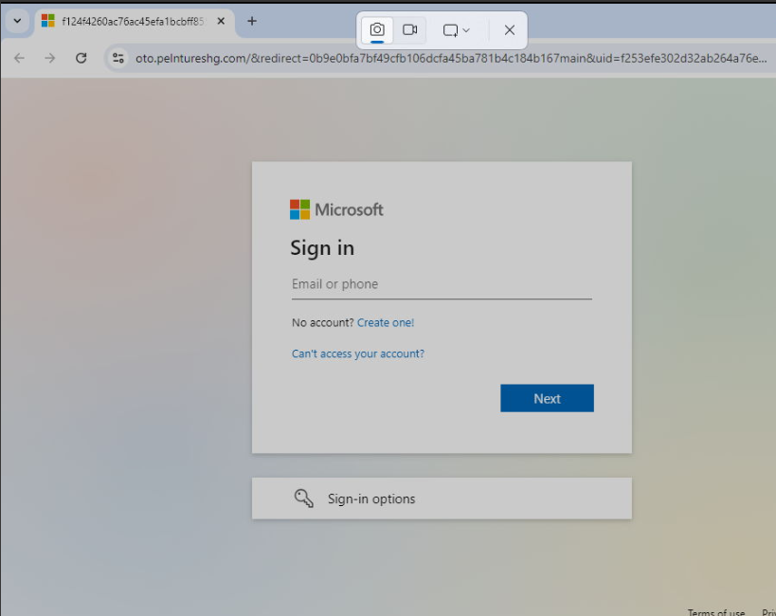
Phishing Kits
Key Features
  Replica login pages (Microsoft 365, banks, government portals, etc.)
  Automated credential harvesting
  Built-in email templates
  Bypass mechanisms (CAPTCHA, MFA interception)

Slide 10
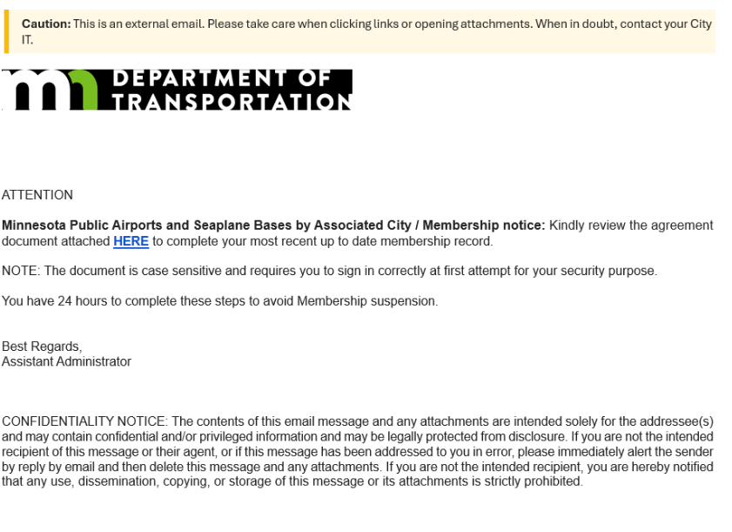
Phishing Kits
Why They’re Dangerous
  Lower threat actor barrier of entry
  Scalable
  Highly customizable to easily target specific agencies, entities or industry sectors

Slide 11

Managed Detection and Response (MDR) Program
Grant-subsidized cybersecurity service available to local governments
  Fully managed, anti-virus tool to detect security risks and malicious activity
  24/7/365 monitoring
  Rapid detection and containment
  Average response time ~ 7 minutes
  MNIT’s Security Operations Center support and visibility
  Full remediation support, incident warranty

Slide 12

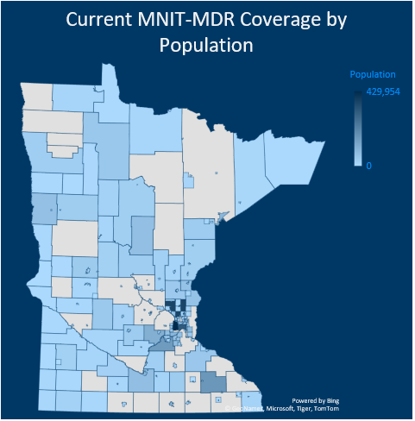
MDR Visibility/Coverage
Population
400,000
0
12
Notes:
61/87 county 70%

Slide 13
Managed Detection and Response Metrics – Past 90 Days
By Severity | Detections
Critical | 14
High | 475
Medium | 223
Low | 11072
Informational | 301
Total | 12085

Slide 14
Managed Detection and Response Metrics – Past 90 Days
Tactics | High and Critical - Alerts
Command and Control | 26
Credential Access | 98
Custom Intelligence | 4
Defense Evasion | 151
Execution | 69
Exploit | 2
Falcon Intel | 48
Falcon Overwatch | 3
Impact | 25
Machine Learning | 54
Malware | 5
Persistence | 11
Post Exploit | 3
Privilege Escalation | 4
Tactics Based on CrowdStrike and Mitre Att&ck Framework
Notes:
Credential Access Attempts to steal account credentials or authentication material (passwords, tokens, ticket harvesting) to impersonate users or services.
Command and Control Attacks where threat actors attempt to maintain remote control over compromised system
Custom Intelligence Attacks that were caught via IOC's that were manually added
Defense Evasion Actions to avoid detection or impede analysis (obfuscation, disabling security tools, timestomping, living-off-the-land).
Execution Running malicious code or commands on a system (scripts, binaries, scheduled tasks) to carry out attacker objectives.
Falcon Intel Threat-intelligence driven detections based on CrowdStrike’s adversary profiling, indicators, and intelligence reports; these alerts often indicate attribution, campaign context, or matches to known-bad infrastructure.
Impact Actions that disrupt, degrade, or destroy systems or data to achieve the attacker’s end goal (ransomware encryption, data destruction, service outages).
Machine Learning Alerts that were discovered and stopped via flagged malicious behavior using trained models rather than signature, manual IOCs
Malware Attacks using file/process that indicate malicious payloads
Persistence Mechanism Techniques that allow adversaries to maintain a foothold across reboots or credential changes (services, scheduled tasks, backdoors).
Post Exploit Behaviour consistent with activity after initial compromise (e.g., credential theft, lateral movement, persistence)
Falcon Overwatch Attacks that were stopped by the Falcon Overwatch threat hunting team. These usually include

Slide 15
Tactics: Defense Evasion
Defense Evasion: Techniques that hide malicious activity or frustrate detection, obfuscation, disabling security controls
Node.js Malware Variant: On October 8th, 2025, MNIT detected a potentially new Node.js malware variant. Node.js is a legitimate open-source JavaScript runtime environment used by developers to run JavaScript on servers or desktops, not just web browsers. Threat actors have been observed misusing Node.js to disguise malware as legitimate processes to evade security defenses.

Slide 16
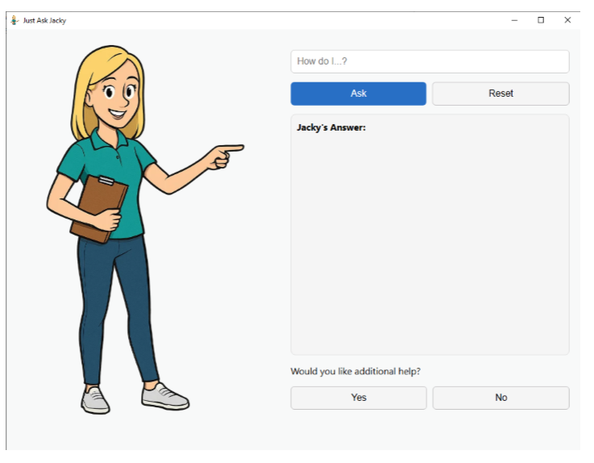
Tactics: Defense Evasion
MNIT detected variant of “JustaskJacky” campaign utilizing node.js malware to harvest data.
Details: JustaskJacky is a fake AI assistant that attempts to trick users into downloading a malicious installer. The installer then drops a malicious copy of node.js which is used to launch a JavaScript data harvester.
Impact: Found in local governments and executive branch environments. Processes blocked and remediated.

Slide 17

Tactics: Credential Access
Credential Access Attacks: Techniques used to steal credentials or authentication material (passwords, hashes, tokens, Kerberos tickets)
Phishing Kits
Credential Harvesting and Fake login pages
Business Compromise Emails
Notes:
98

Slide 18

Tactics: Execution
CLICK
Execution: Running code or commands on a system (scripts, binaries, scheduled tasks, services). The step where attacker code runs.
Clickfix: MNIT has observed increase in ClickFix attacks in the state of Minnesota environment. Clickfix is a social engineering technique that attempts to trick users into manually executing malicious code on their own computer.
FIX
Notes:
69

Slide 19
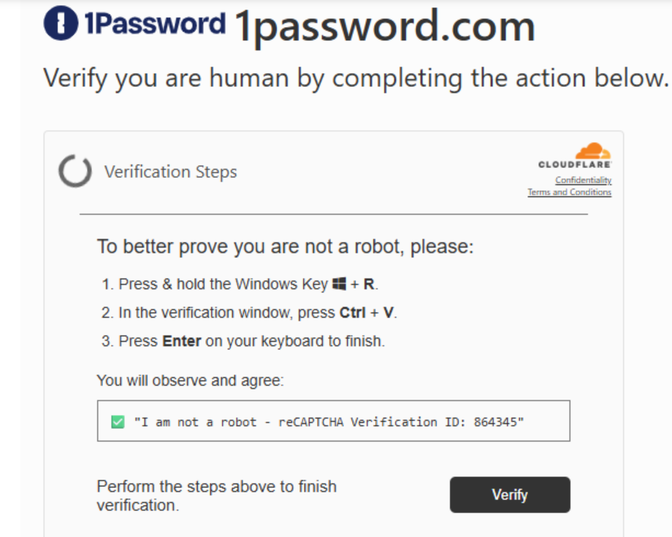
Tactics: Execution
Clickfix Example: Threat actors use social engineering tactics to trick users into navigating to a malicious Clickfix website.
The malicious site prompts the visitor to interact with the page, usually by clicking on a fake captcha test.

Slide 20
Tactics: Execution
Clickfix Example: Once the visitor clicks on the “verify” button, the ClickFix page automatically copies PowerShell code to the visitor’s clipboard. The malicious website then displays a prompt telling the visitor to paste the PowerShell code into the Windows Run menu.
Running the malicious code in the Windows run menu begins drops malware onto the visitor's device.
Impact: Found in local governments and executive branch environments. Processes blocked and remediated.

Slide 21
Cyber Threat Landscape
Incident Response – Approach and Best Practice

Slide 22

Incident Response
What is Incident Response?
Goals:
  Contain and eradicate threats quickly
  Protect critical systems and data
  Reduce business disruption
  Improve resilience and future readiness
Notes:
Incident Response (IR) is a structured approach to identifying, managing, and recovering from cybersecurity incidents to minimize impact and restore normal operations.

Slide 23
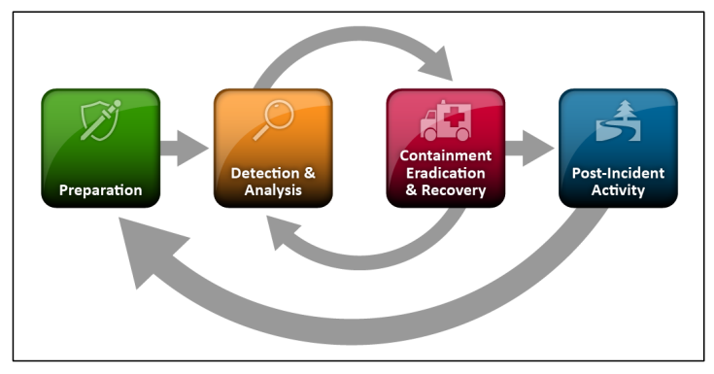
Incident Response Lifecycle
Notes:
Understand incident response lifecycle and best practices: This lifecycle is based on NIST’s incident response framework which is a enterprise standard IR framework that has been adapted by many entities world wide including CISA and MNIT.

Slide 24


Incident Response Lifecycle
Preparation: Building out capabilities for an incident occurs
Establish IR plan, roles, contacts, tools
Playbook and procedure development
Create backups
Detection & Analysis: Objective is to quickly confirm and understand incident to initiate the best response
Identifying suspicious activity
Validate incident, triage severity and scope
Begin documentation
  Correlate events document timeline and indicators (IP addresses, usernames, logs)
  Identify root cause (compromised password, exploited vulnerability, insider threat?)
Notes:
Preparation: Building out capabilities before an incident occurs
Detection & Analysis: is the stage in the incident response lifecycle where the potential cybersecurity events are identified, investigated and confirmed as true incidents

Slide 25




Incident Response Lifecycle
Containment: Objective is to prevent further damage and reduce immediate impact of incident by removing the threat actor's access
Isolate affected systems
Network segment, block IPs
Reset passwords
Eradication and Recovery: Objective is to return to “normal operations” by eliminating artifacts of the incident
Remove malware, disable compromised accounts,
Mitigating vulnerabilities or other conditions that were exploited
Restore system from backups
Notes:
Containment: objective is to prevent further damage and reduce immediate impact of incident by removing the threat actor's access
Eradication & Recovery: objective is to return to “normal operations” by eliminating artifcats of the incident
Post Incident Review
Conduct lessons learned, update policies controls and training

Slide 26


Incident Response Lifecycle
Post-Incident Activities: Goal is to document the incident, inform leadership, harden environment to prevent similar incidents and apply lessons learned
Conduct lessons learned analysis
Update policies controls and training
Update roles and responsibilities
Improving tools required to perform protection,
detection, analysis or response actions
Notes:
Post Incident Review: Goal is to document the incident, inform leadership, harden environment to prevent similar incidents and apply lessons learned

Slide 27
Incident Response Lifecycle
Key Takeaway
Incident response is a continuous improvement cycle that strengthens the organization's ability to prevent and withstand future attacks.
Incident Response Playbooks Templates and Resources
  CISA Incident Response Plan
  NIST Cybersecurity Framework

Slide 28
Cyber Threat Landscape
MNIT Services

Slide 29
Cybersecurity Incident Reporting Requirements
Who must report
  State agencies, political subdivisions; school districts, charter schools, intermediate districts, cooperative units, and public post-secondary (higher education) institutions.
  Government contractors or vendors that provide goods or services to a public agency must report an incident to the public agency.
When to report
  Within 24 hours if Criminal Justice Information is impacted.
  Within 72 hours of when incident was identified or occurred.
Reporting: mn.gov/mnit/cir

Slide 30
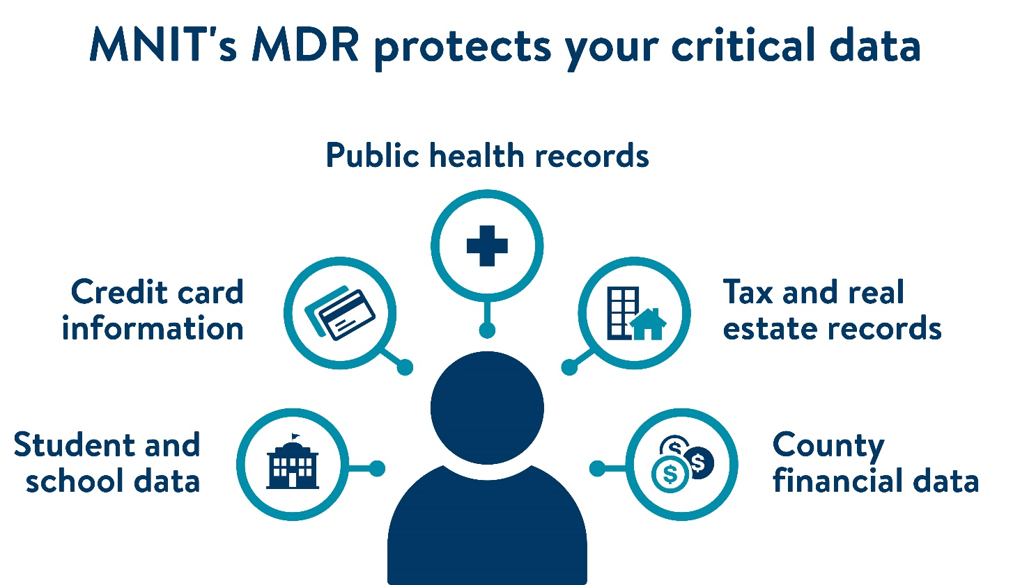
MDR works 24/7 to protect sensitive data
MNIT’s MDR program safeguards the integrity of Minnesota’s data
Local government records
K-12 schools’ systems, student data
Critical infrastructure
Criminal Justice Information (CJI)

Slide 31
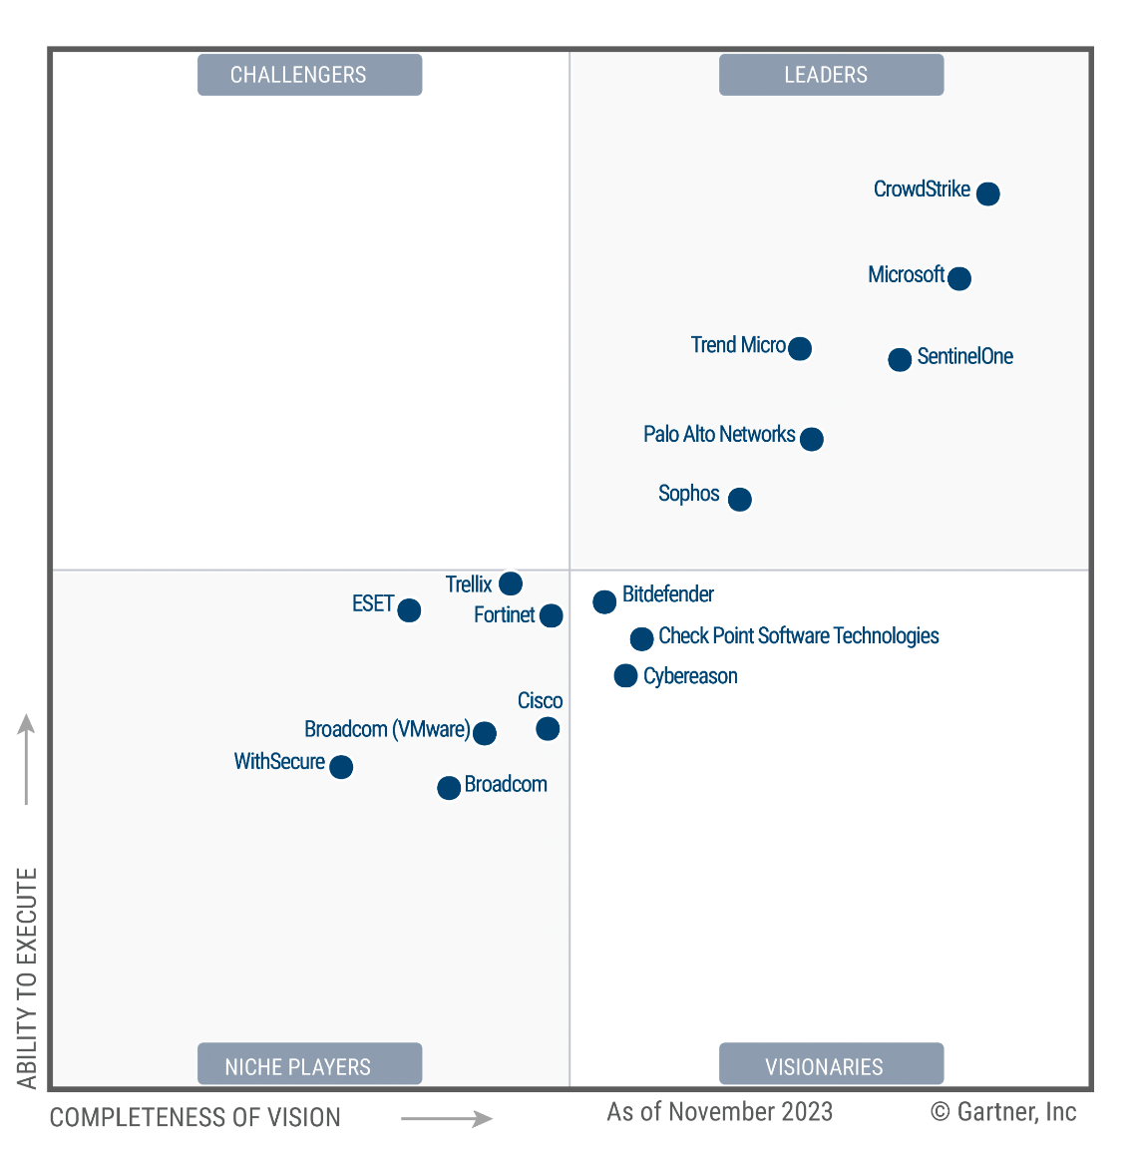
Value of MNIT’s MDR Program
MDR looks for and blocks the types of attacks that could lead to data breaches, ransomware
  Reduces operational disruption
  Low-cost, high-value solution
  Cost-sharing model
Magic Quadrant for Endpoint Protection Platforms
CrowdStrike
MDR cost structure per device
2025 | $22
2026 | $32
2027 | $38
Post-SLCGP | TBD
*per device annually; current rates

Slide 32
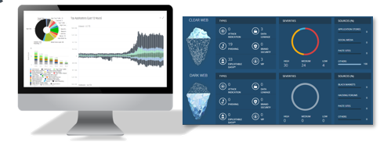
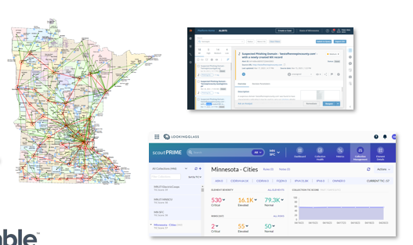

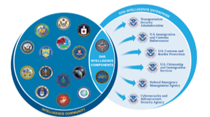

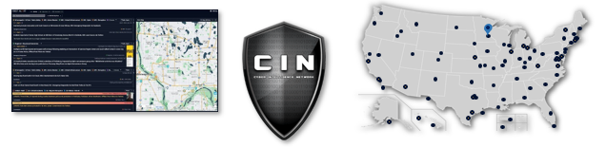
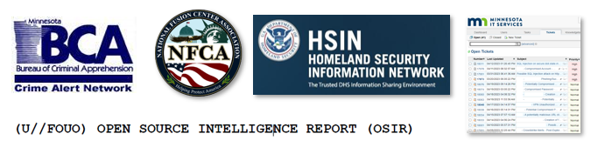
Cyber Threat Intelligence
Centralize feeds
Dedicated resource
Proactive intelligence gathering
Processing event data (IOCs, TTPs, reporting)

Slide 33

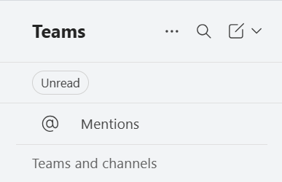
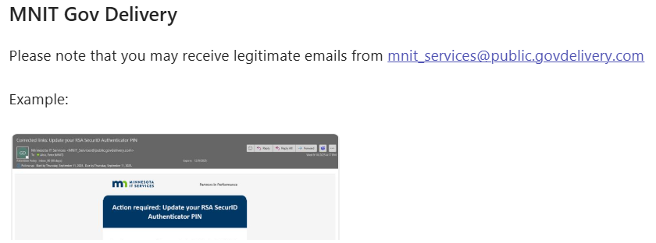
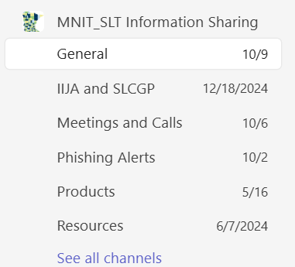
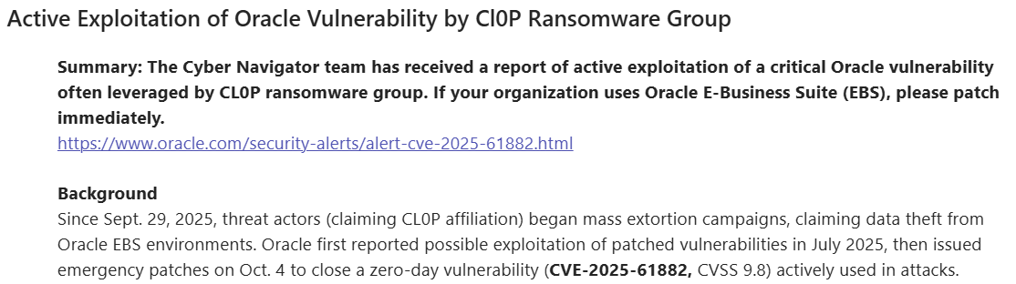
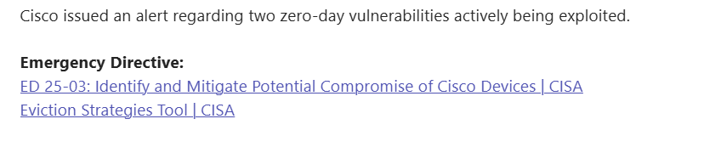
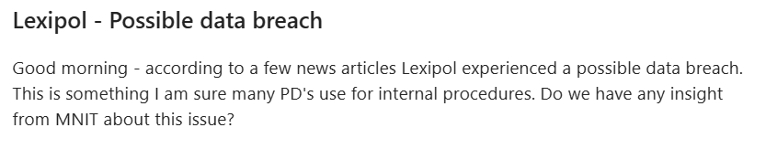
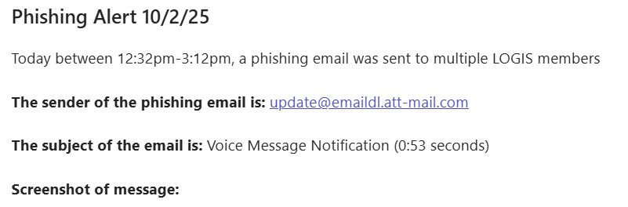
SLT Page & Meeting
Regular posts on a range of topics
400+ members from SLT & K12
Meet first Tuesday each month

Slide 34



Risk Assessments
Cybersecurity and Infrastructure Security Agency
  Cybersecurity Performance Goals
  Ransomware Readiness Assessment
  Onsite
Minnesota National Guard
  Hardware/software scans
  Defense Information Systems Agency (DISA) Security Technical Implementation Guides (STIGs)
Metro State University
  Center for Internet Security (CIS) Critical Security Controls
  Implementation Group 1 - Essential Cyber Hygiene

Slide 35
How to Participate!
Foua Xiong
Cyber Navigator – Local Governments
Lee.Xiong@state.mn.us
Cyber Navigator Team: CN.MNIT@state.mn.us

